Slide 1

experience.sap.com/designservices/scenes

Slide 2


Slide 3
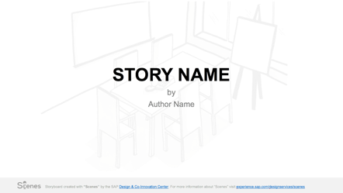
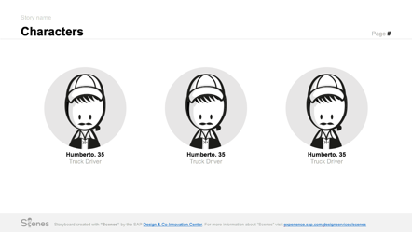
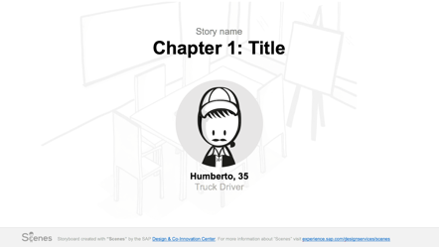
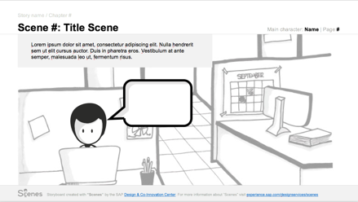
Structure your story
The events in a story are put together following a certain narrative structure. To make this structure easier to recognize, we have created some pre-defined templates that you can use to mark the different sections of your storyboard.
Title Slide
Include the title of the story and authors. You can also have a light background illustrating the main setting of your story.
Characters Slide
Include a slide in the beginning showing who protagonizes your story. Indicate the name and the role for each character.
Chapter Slide
In the case of long stories, it might be necessary to group the scenes in chapters. Use a title slide to indicate these groups.
Indicate who is the main character in the chapter.
Scene Slide
Use a slide for each scene. Include the scene number and give it a title. Don’t forget to add some caption indicating what the scene is about. Use the elements from the Scenes library to compose your scenes.

Slide 4
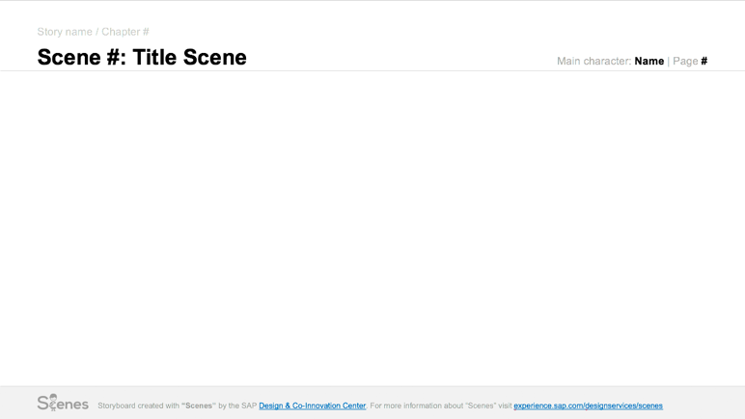
Create a scene
Every story is composed of 2 or more “Scenes”. This is how you can build them in PowerPoint:
Indicate the story title
Indicate who is the main character in that Scene.
Don’t forget the number of the page. Is not always the same as the scene.
Indicate the
Scene number and a title for your scene.
Every Scene is a new slide.
Use the official footer.

Slide 5

Create a scene
Use the illustrations in the “Scenes” library to illustrate your “Scenes”
Add a caption: what is happening in the scene?
Add characters and other elements to compose your story.
Add backgrounds from the Scenes library to indicate the location

Slide 6


Slide 7

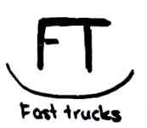
LATE TRUCK
by
The “Scenes” team

Slide 8



LATE TRUCK
Characters
Page 02
Max, 35
Truck driver
Ed, 41
Logistics manager
Maria, 32
Max’s wife

Slide 9
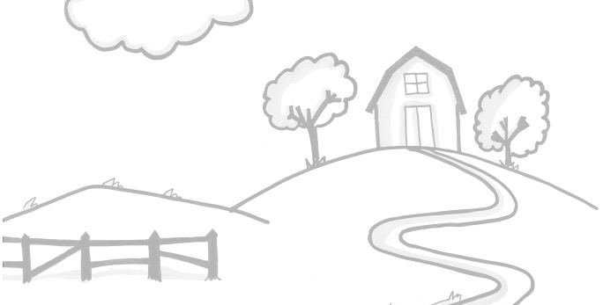
LATE TRUCK
Scene 1: Good bye
Main character: Max | Page 03
It’s Monday morning. Max has to travel to Stuttgart with his truck. The application tells him the destination and approximate arrival time.
Bye Max! Have a safe trip!
Origin:
BERLIN
stination:
UTTGART
ON TIME!
Arrival:
15:30
Thank you! Bye!

Slide 10
LATE TRUCK
Scene 2: Traffic jam
Main character: Max | Page 04
But an unexpected traffic jam occurs on the way…
Origin:
BERLIN
stination:
UTTGART
TRAFFIC JAM!
NOTIFICATION SENT
Traffic Jam!
I’ll never make it on time!

Slide 11
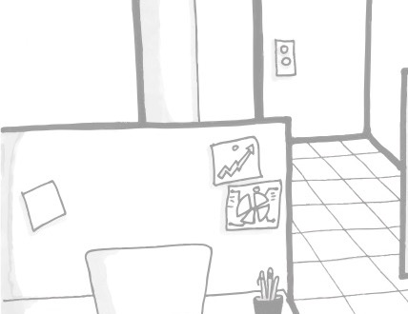
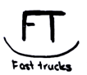
LATE TRUCK
Scene 3: Alternative truck
Main character: Ed | Page 04
But thanks to a quick notification, Ed can choose an alternative on time.
Don’t worry Max! I have chosen an alternative truck!
TRUCK 5 LATE!
Truck 5
Select alternatives:
Hi Ed!
I’m stuck in a traffic jam!
Truck 3
Truck 7

Slide 12


Slide 13
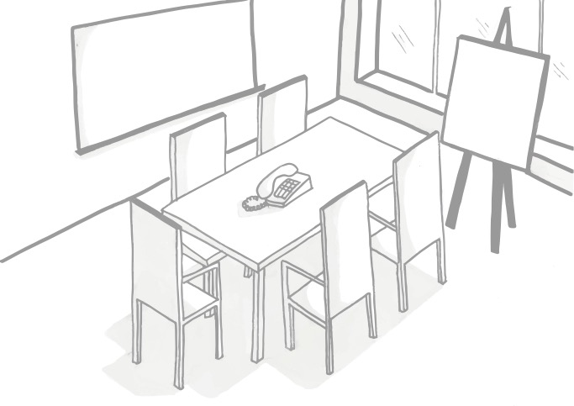
STORY NAME
by
Author Name

Slide 14
Story name
Characters
Page #
Humberto, 35
Truck Driver
Name, age
Role
Name, age
Role

Slide 15
Story name
Characters
Page #
Humberto, 35
Truck Driver
Name, age
Role
Name, age
Role
Name, age
Role
Name, age
Role
Name, age
Role

Slide 16
Story name
Chapter 1: Title
Humberto, 35
Truck Driver

Slide 17
Story name / Chapter #
Scene #: Title Scene
Main character: Name | Page #
[ADD “SCENES” ILLUSTRATIONS HERE]
[ADD CAPTION HERE]

Slide 18
Story name / Chapter #
Scene #: Title Scene
Main character: Name | Page #
[ADD CAPTION HERE]
[ADD “SCENES” ILLUSTRATIONS HERE]

Slide 19


Slide 20
CHARACTERS

Slide 21
CHARACTERS

Slide 22
CHARACTERS

Slide 23
SPEECH BUBBLES & ARROWS

Slide 24
DEVICES

Slide 25
DEVICES

Slide 26
SIGNS

Slide 27
OFFICE FURNITURE

Slide 28
TRANSPORTATION

Slide 29
TRANSPORTATION

Slide 30
BUILDINGS

Slide 31
BUILDINGS

Slide 32
BUILDINGS

Slide 33

BACKGROUNDS

Slide 34
BACKGROUNDS

Slide 35
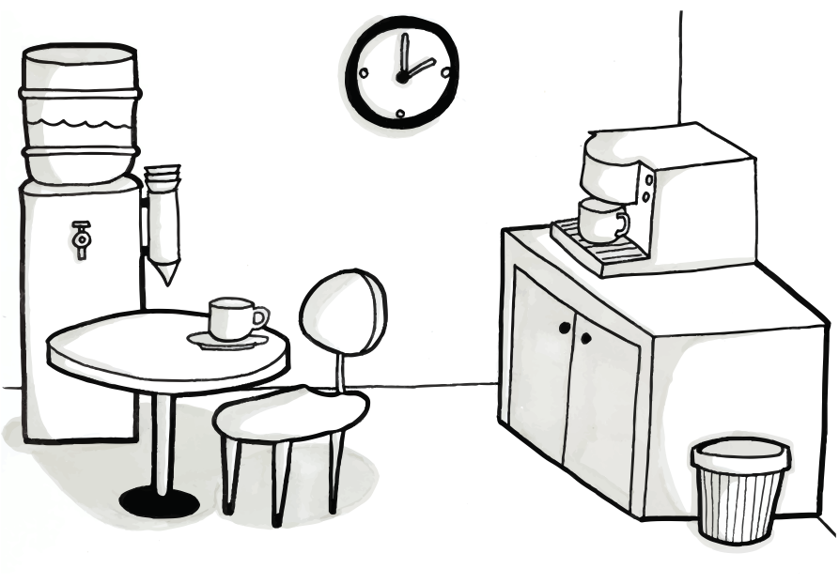
BACKGROUNDS

Slide 36
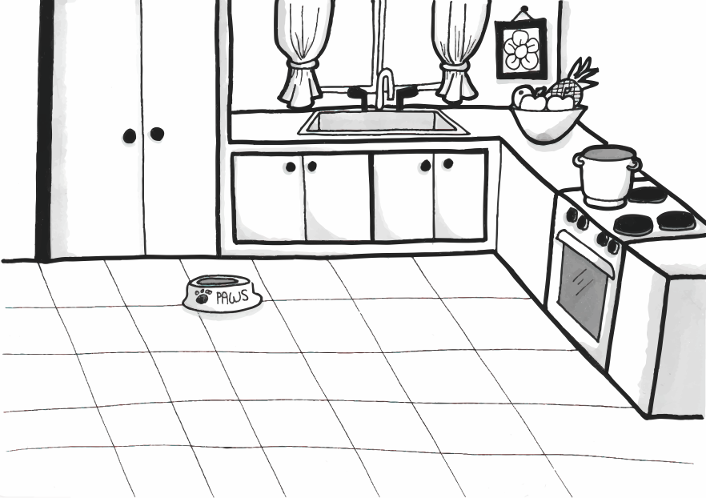
BACKGROUNDS

Slide 37
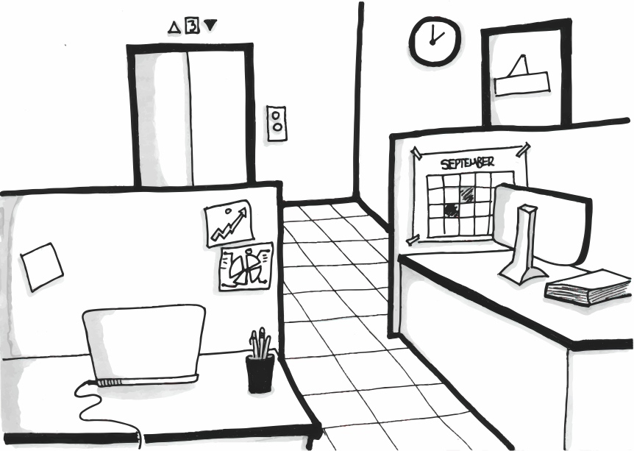
BACKGROUNDS

Slide 38
BACKGROUNDS

